Slide 1
CHAPTER 7
Continuous Probability Distributions
to accompany
Introduction to Business Statistics
seventh edition, by Ronald M. Weiers
Presentation by Priscilla Chaffe-Stengel
Donald N. Stengel
© 2011 Cengage Learning.
All Rights Reserved. May not be scanned, copied, or duplicated, or posted to a publicly accessible website, in whole or in part.

Slide 2
Chapter 7 - Learning Objectives
Differentiate between the normal and the exponential distributions.
Use the standard normal distribution and z-scores to determine probabilities associated with the normal distribution.
Use the normal distribution to approximate the binomial distribution.
Use the exponential distribution to determine related probabilities.
© 2011 Cengage Learning.
All Rights Reserved. May not be scanned, copied, or duplicated, or posted to a publicly accessible website, in whole or in part.

Slide 3
Chapter 7 - Key Terms
Probability density function
Probability distributions
  Standard normal distribution
    Mean, variance, applications
  Exponential distribution
    Mean, variance, applications
Normal approximation to the binomial distribution
© 2011 Cengage Learning.
All Rights Reserved. May not be scanned, copied, or duplicated, or posted to a publicly accessible website, in whole or in part.

Slide 4
Chapter 7 - Key Concept
The area under a probability density function between two bounds, a and b, is the probability that a value will occur within the bounded interval between a and b.
© 2011 Cengage Learning.
All Rights Reserved. May not be scanned, copied, or duplicated, or posted to a publicly accessible website, in whole or in part.

Slide 5
The Normal Distribution
An important family of continuous distributions
Bell-shaped, symmetric, and asymptotic
To specify a particular distribution in this family, two parameters must be given:
  Mean
  Standard deviation
© 2011 Cengage Learning.
All Rights Reserved. May not be scanned, copied, or duplicated, or posted to a publicly accessible website, in whole or in part.

Slide 6
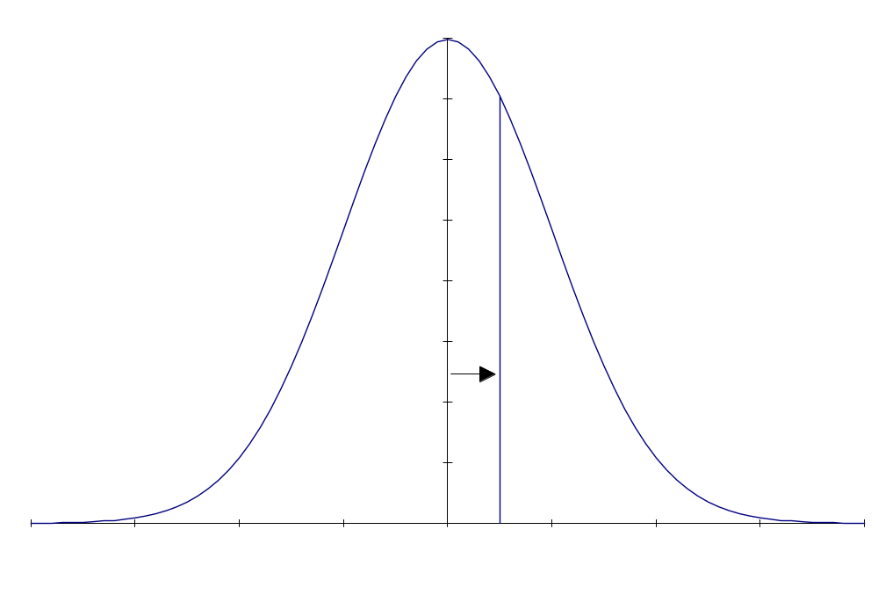
Areas under the Normal Curve
Use the standard normal table to find:
The z-score such that the area from the midpoint to z is 0.20.
In the interior of the standard normal
table, look up a value close to 0.70.
since 70% of the area is below the
z. The closest value is 0.1985,
which occurs at z = 0.52.
© 2011 Cengage Learning.
All Rights Reserved. May not be scanned, copied, or duplicated, or posted to a publicly accessible website, in whole or in part.

Slide 7
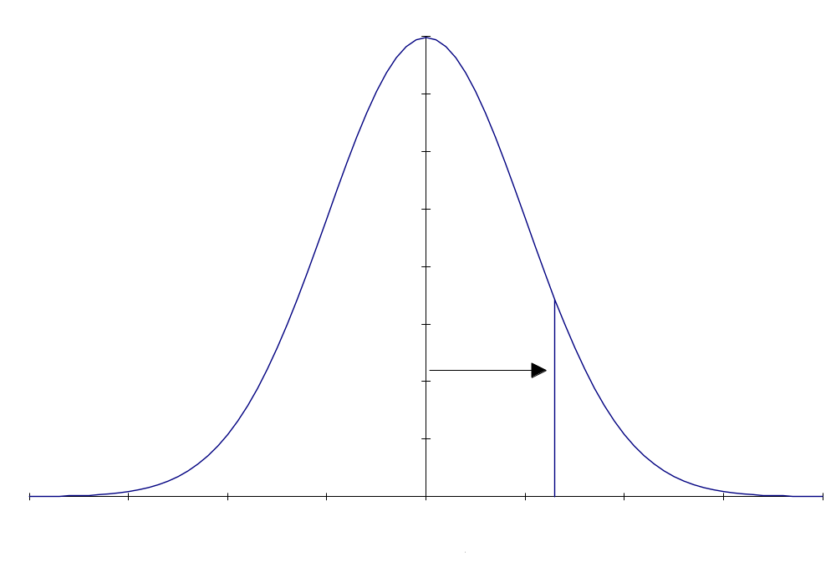
Areas under the Normal Curve
Use the standard normal table to find:
The probability associated with z: P(0 ≤ z ≤ 1.32).
Locate the row whose header is 1.3. Proceed
along that row to the column whose
header is .02, because the value in
the hundredths place of the z-score
is 2. There you find the value
.9066, which is the amount of
area capture below a z of 1.32.
Subtract the area below the
mean of 0.5.
Answer: 0.4066
© 2011 Cengage Learning.
All Rights Reserved. May not be scanned, copied, or duplicated, or posted to a publicly accessible website, in whole or in part.

Slide 8
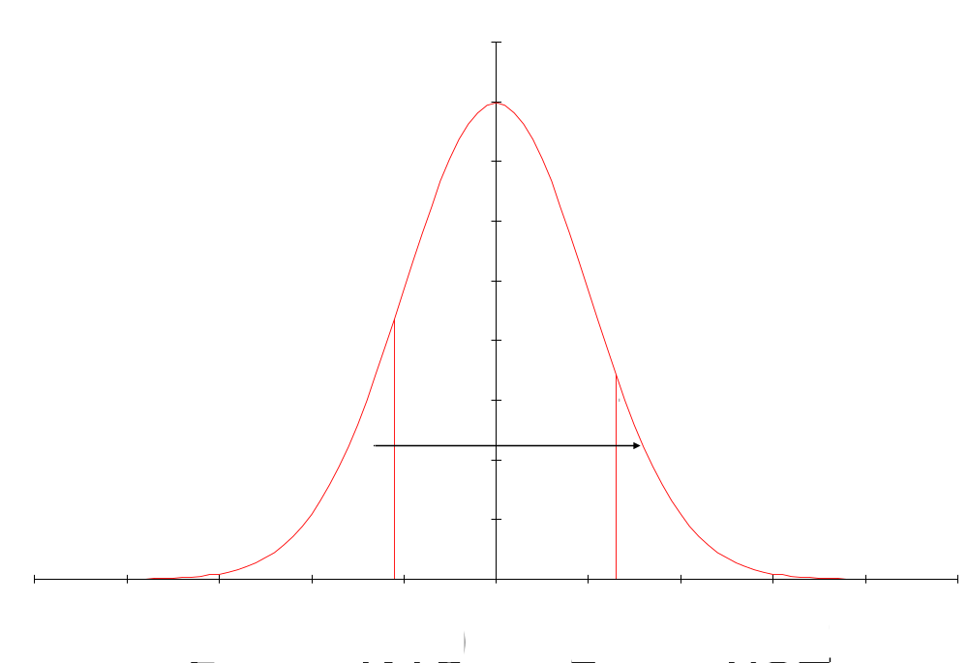
Areas under the Normal Curve
Use the standard normal table to find:
The probability associated with z: P(–1.10 ≤ z ≤ 1.32).
Find the amount of area below
z = 1.32 and subtract the area
below z = -1.10.
0.9066 – 0.1357 = 0.7709
© 2011 Cengage Learning.
All Rights Reserved. May not be scanned, copied, or duplicated, or posted to a publicly accessible website, in whole or in part.

Slide 9
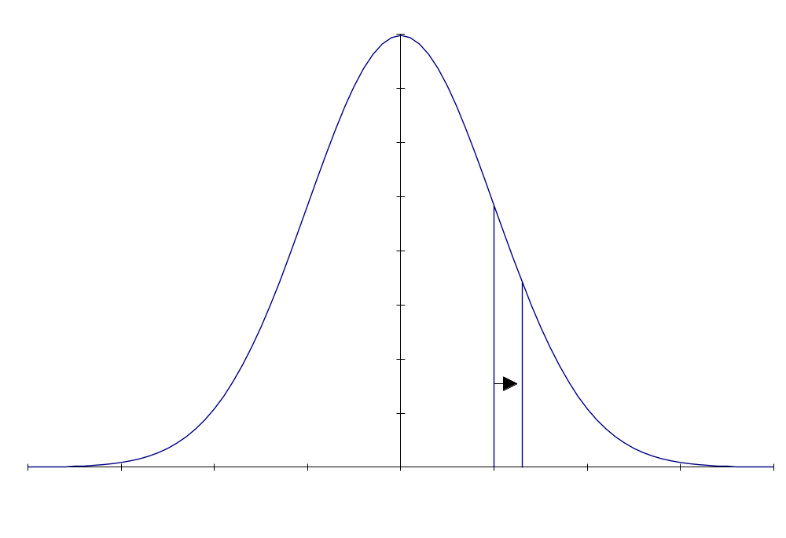
Areas under the Normal Curve
Use the standard normal table to find:
The probability associated with z: P(1.00 ≤ z ≤ 1.32).
Find the area below z = 1.32 and
subtract the area below z = 1.00.
0.9066 – 0.8413 = 0.0653
© 2011 Cengage Learning.
All Rights Reserved. May not be scanned, copied, or duplicated, or posted to a publicly accessible website, in whole or in part.

Slide 10
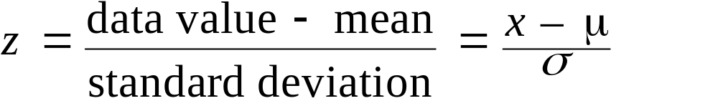
Standardizing Individual Data Values on a Normal Curve
The standardized z-score is how far above or below the individual value is compared to the population mean in units of standard deviation.
  “How far above or below”= data value – mean
  “In units of standard deviation”= divide by σ
Standardized individual value
© 2011 Cengage Learning.
All Rights Reserved. May not be scanned, copied, or duplicated, or posted to a publicly accessible website, in whole or in part.

Slide 11
Standard Normal Distribution:
An Example
It has been reported that the average hotel check-in time, from curbside to delivery of bags into the room, is 12.1 minutes. Mary has just left the cab that brought her to her hotel. Assuming a normal distribution with a standard deviation of 2.0 minutes, what is the probability that the time required for Mary and her bags to get to the room will be:
a) greater than 14.1 minutes?
b) less than 8.1 minutes?
c) between 10.1 and 14.1 minutes?
d) between 10.1 and 16.1 minutes?
© 2011 Cengage Learning.
All Rights Reserved. May not be scanned, copied, or duplicated, or posted to a publicly accessible website, in whole or in part.

Slide 12
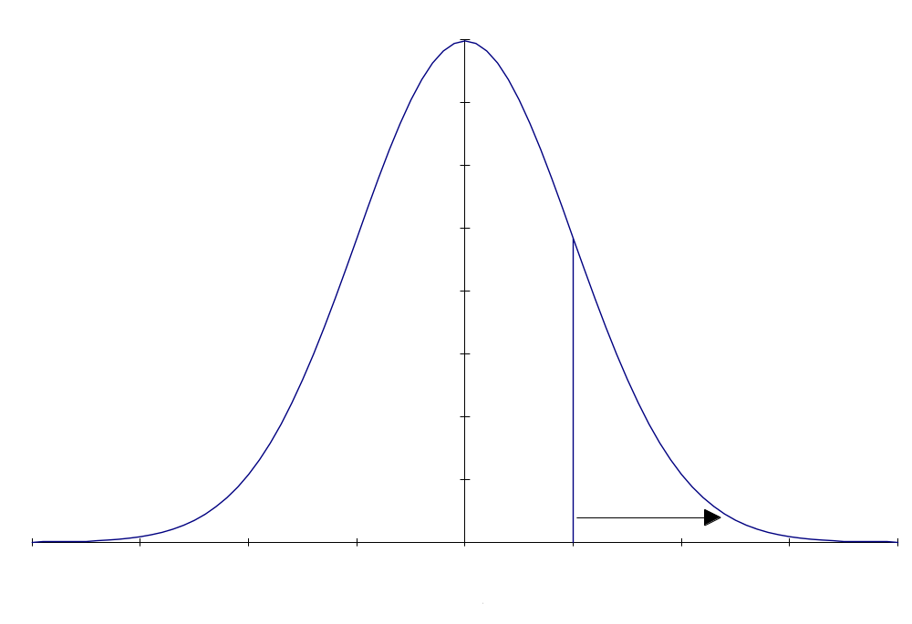
An Example, continued
Given in the problem:
  µ = 12.1 minutes, σ = 2.0 minutes
a) Greater than 14.1 minutes
P(x > 14.1) = P(z > 1.00)
= 1 – .8413 = 0.1587
x
–
μ
14
.
1
–
12
.
1
z
=
=
=
1
.
00
σ
2
.
0
© 2011 Cengage Learning.
All Rights Reserved. May not be scanned, copied, or duplicated, or posted to a publicly accessible website, in whole or in part.

Slide 13
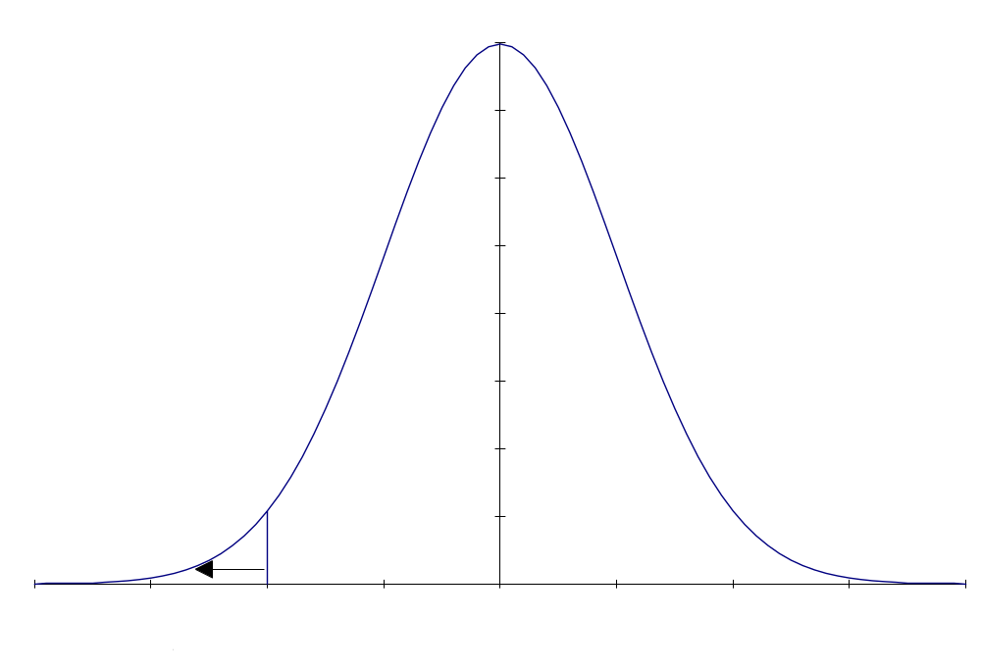
An Example, continued
Given in the problem:
  µ = 12.1 minutes, σ = 2.0 minutes
b) Less than 8.1 minutes
P(x < 8.1) = P(z < –2.00)
= 0.0228
x
–
μ
8
.
1
–
12
.
1
z
=
=
=
–
2
.
00
σ
2
.
0
© 2011 Cengage Learning.
All Rights Reserved. May not be scanned, copied, or duplicated, or posted to a publicly accessible website, in whole or in part.

Slide 14
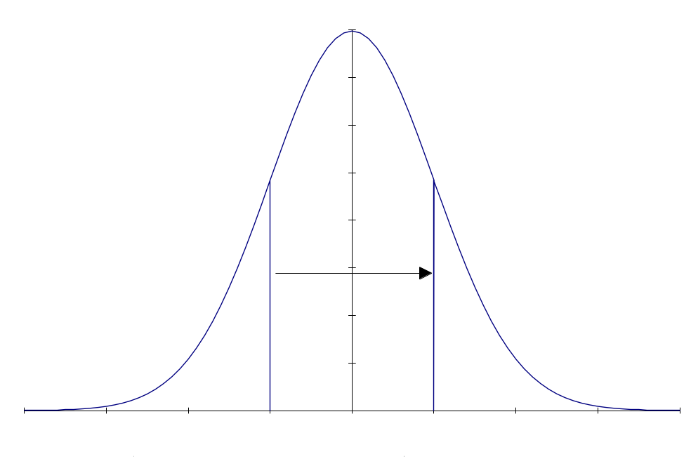
An Example, continued
Given in the problem:
  µ = 12.1 minutes, σ = 2.0 minutes
c) Between 10.1 and 14.1 minutes
P(10.1 < x < 14.1)
= P(–1.00 < z < 1.00)
= 0.8413 - 0.1587 = 0.6826
x
–
μ
10
.
1
–
12
.
1
z
=
=
=
–
1
.
00
lower
σ
2
.
0
x
–
μ
14
.
1
–
12
.
1
z
=
=
=
1
.
00
upper
σ
2
.
0
© 2011 Cengage Learning.
All Rights Reserved. May not be scanned, copied, or duplicated, or posted to a publicly accessible website, in whole or in part.

Slide 15
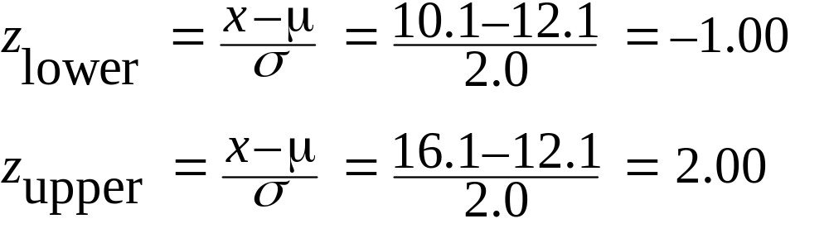
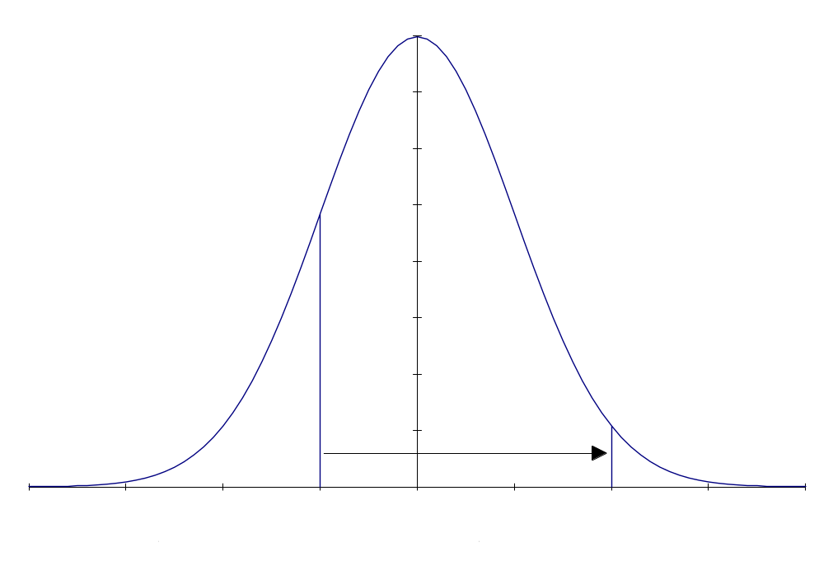
An Example, continued
Given in the problem:
  µ = 12.1 minutes, σ = 2.0 minutes
d) Between 10.1 and 16.1 minutes
P(10.1 < x < 16.1)
= P(–1.00 < z < 2.00)
= 0.9772 – 0.1587 = 0.8185
© 2011 Cengage Learning.
All Rights Reserved. May not be scanned, copied, or duplicated, or posted to a publicly accessible website, in whole or in part.

Slide 16
Example: Using Microsoft Excel
Problem: What is the probability that the time required for Mary and her bags to get to the room will be:
a) greater than 14.1 minutes?
In a cell on an Excel worksheet, type
=1-NORMDIST(14.1,12.1,2,true)
and you will see the answer: 0.1587
b) less than 8.1 minutes?
In a cell on an Excel worksheet, type
=NORMDIST(8.1,12.1,2,true)
and you will see the answer: 0.0228
© 2011 Cengage Learning.
All Rights Reserved. May not be scanned, copied, or duplicated, or posted to a publicly accessible website, in whole or in part.

Slide 17
Example: Using Microsoft Excel
Problem: What is the probability that the time required for Mary and her bags to get to the room will be:
c) between 10.1 and 14.1 minutes?
In a cell on an Excel worksheet, type all on one line
=NORMDIST(14.1,12.1,2,true)-
NORMDIST(10.1,12.1,2,true)
and you will see the answer: 0.6826
d) between 10.1 and 16.1 minutes?
In a cell on an Excel worksheet, type all on one line
=NORMDIST(16.1,12.1,2,true)-
NORMDIST(10.1,12.1,2,true)
and you will see the answer: 0.8185
© 2011 Cengage Learning.
All Rights Reserved. May not be scanned, copied, or duplicated, or posted to a publicly accessible website, in whole or in part.

Slide 18
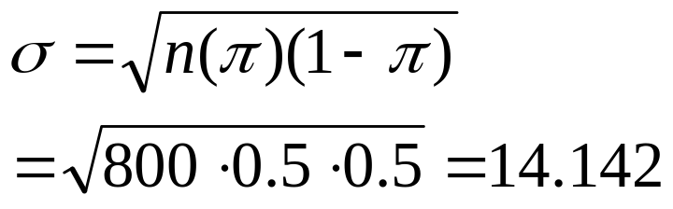
Using the Normal to Approximate the Binomial Distribution
Exercise 7.46: The Electronic Industries Association reports that about 50% of the U.S. households have a camcorder. For a randomly selected sample of 800 U.S. households, use the normal approximation to the binomial distribution in determining the probability that at least 410 of these households have a camcorder.
π = .5, n = 800 μ = nπ = 800(.5) = 400

Slide 19
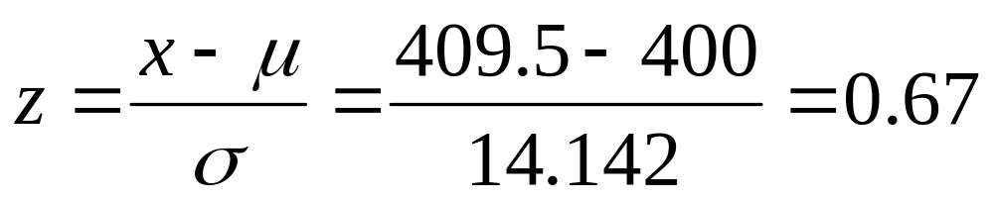
The Normal Approximation to the Binomial Distribution
Exercise 7.46:
P(x ≥ 410) ≈ P(x ≥ 409.5)
P(z > 0.67) = 1 - 0.7486 = 0.2514

Slide 20
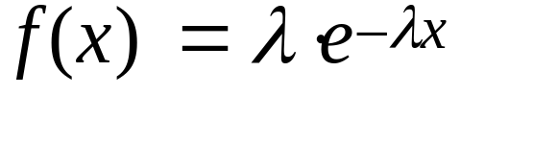
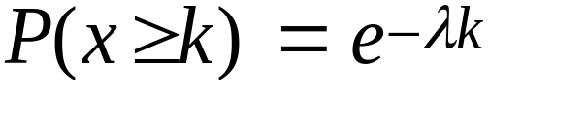
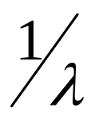
The Exponential Distribution
where λ = mean and standard deviation of the related Poisson distribution
e = 2.71828, a constant
Probability:
  Where mean and standard deviation =
Application: Every day, drivers arrive at a tollbooth. If the Poisson distribution were applied to this process, what would be an appropriate random variable? What would be the exponential distribution counterpart to this random variable?
© 2011 Cengage Learning.
All Rights Reserved. May not be scanned, copied, or duplicated, or posted to a publicly accessible website, in whole or in part.

Slide 21
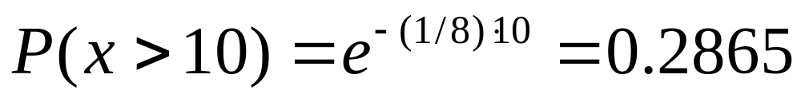
The Exponential Distribution,
An Example Worked with Equations
Example, Problem 7.55: The owner of a self-service car wash has found that customers take an average of 8 minutes to wash and dry their cars. Assuming that the self-service times tend to be exponentially distributed, what is the probability that a customer will require more than 10 minutes to complete the job?
© 2011 Cengage Learning.
All Rights Reserved. May not be scanned, copied, or duplicated, or posted to a publicly accessible website, in whole or in part.

Slide 22
The Exponential Distribution,
An Example Worked with Excel
Example, Problem 7.55: The Owner of a self-service car wash has found that customers take an average of 8 minutes to wash and dry their cars. Assuming that the self-service times tend to be exponentially distributed, what is the probability that a customer will require more than 10 minutes to complete the job?
In a cell on an Excel worksheet, type =1-EXPONDIST(10,0.125,true)
and you will see the answer: 0.2865
© 2011 Cengage Learning.
All Rights Reserved. May not be scanned, copied, or duplicated, or posted to a publicly accessible website, in whole or in part.

